Slide 1
19AIE201 INTRODUCTION TO ROBOTICS
TEAM -12

Slide 2
TEAMS MEMBERS
KARTHIKEYAN M
NALIN M R
PRAGADISHWARAN K
KARTHIK RAJA B
CHANDU JANAKIRAM

Slide 3
02
01
KUKA KR3
DH PARAMETERS
03
04
FORWARD KINEMATICS
INVERSE KINEMATICS
05
TRAJECTORY PLANNING
06
CONCLUSION

Slide 4
KUKA KR3
We are analyzing the forward and inverse kinematics of KUKA KR3 . We are calculating the forward kinematics using the transformation matrix and inverse kinematics using the decoupling Method based and also performing trajectory planning.

Slide 5
Overview of the robot system
A robot system comprises all the assemblies of an industrial robot, including the manipulator (mechanical system and electrical installations), control cabinet, connecting cables, end effector (tool) and other equipment. The KR AGILUS six product family consists of the following types:
KR 3 R540
KR 6 R700 sixx ,
KR 6 R900 sixx
KR 10 R900 sixx
KR 10 R1100 sixx

Slide 6
KUKA KR3
The KR 3 is suitable when small components and products have to be manufactured in a minimum of space.
It can be utilized for tiny component assembly, handling, screw fastening, adhesive bonding, packaging, and inspection anywhere short production cycles and high output are required.
The KUKA KR3 offers maximum production per square metre due to its small size.
This combination makes the robot especially appealing to the electronics industry.
It is an injection Molding robot.
Axis: 6 Axis
Payload: 3Kg
Max. reach : 635 mm

Slide 7
The KR 3 R540 is designed for a rated payload of 2 kg in order to optimize the
dynamic performance of the robot. With reduced load center distances, higher loads
up to the maximum payload may be used. The specific load case must be verified
using KUKA.Load.
The intelligent design of the KR 3 R540 (AGILUS) makes it a very cost-effective, reliable
robot that is one of the fastest in its class. It is the answer for your next project that
requires minimum cycle times while producing maximum output. The 6 axis KR 3
AGILUS is the ideal robot for the production of small parts or for tackling any of the
following applications that requires a 3 kg payload: pick and place, screw fastening,
brazing, adhesive bonding, packaging, testing and checking, and much more.
In addition, the KR 3 R540 robot is compact, has a 541 mm reach, and works perfectly
in confined spaces or 600 x 600 mm automation cells. Overall, the KR 3 AGILUS is a
trustworthy automationsolution that will end up saving you money in numerous areas,
including lower maintenance costs.

Slide 8
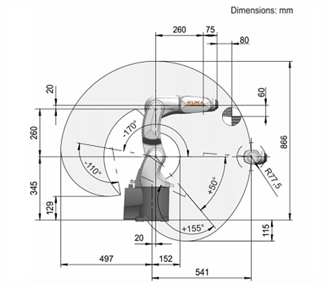
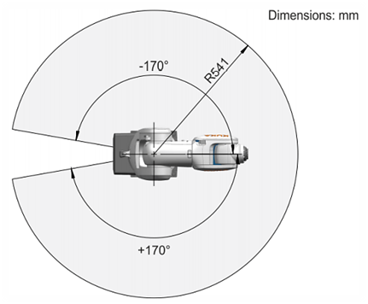
WORKSPACE
SIDE VIEW
TOP VIEW

Slide 9
APPLICATIONS
Machine loading and parts handling
Laboratory automation
Product testing
Assembly
Arc welding
Machining tasks, such as grinding, polishing, and deburring

Slide 10
In the following approach, a procedure based on the D-H convention is used to calculate the forward kinematics of any manipulator.
Step l: Locate and label the joint axes z0,. .. ,zn−1.
Step 2: Establish the base frame. Set the origin anywhere on the z0-axis. The x0 and y0 axes are chosen conveniently to form a right-hand frame. For i = 1,. .. ,n − 1, perform Steps 3 to 5.
Step 3: Locate the origin Oi where the common normal to zi and zi−1 intersects zi . If zi intersects zi−1 locate Oi at this intersection. If zi and zi−1 are parallel, locate Oi in any convenient position along zi .
Step 4: Establish xi along the common normal between zi−1 and zi through Oi , or in the direction normal to the zi−1 − zi plane if zi−1 and zi intersect.
Step 5: Establish yi to complete a right-hand frame.

Slide 11
Step 6: Create a table of link parameters ai , di , αi , θi .
ai = distance along xi from Oi to the intersection of the xi and zi−1 axes.
di = distance along zi−1 from Oi−1 to the intersection of the xi and zi−1 axes. di is
variable if joint i is prismatic.
αi = the angle between zi−1 and zi measured about xi.
θi = the angle between xi−1 and xi measured about zi−1 (see Figure 3.3). θi is
variable if joint i is revolute.
Step 8: Form the homogeneous transformation matrices Ai by substituting the above parameters
Step 9: Form . This then gives the position and orientation of the tool frame expressed in base coordinates.

Slide 12
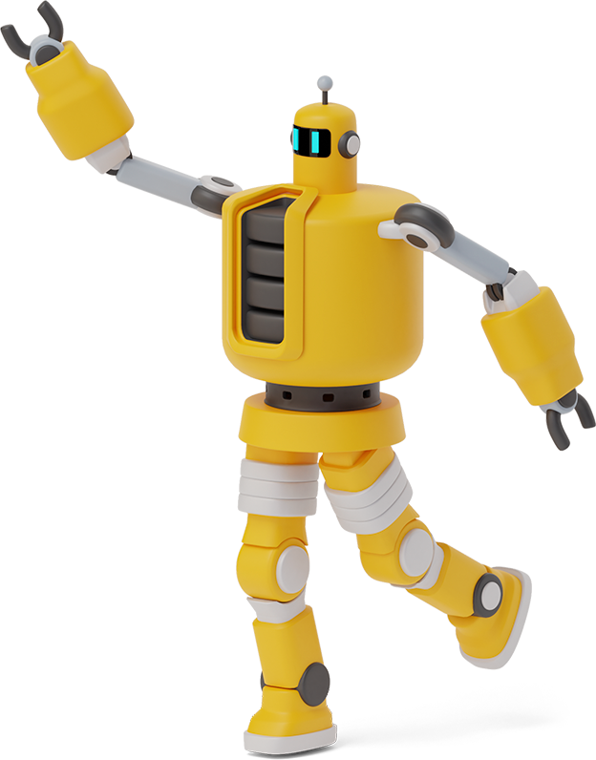
STANDARD DH Parameters
Link length
ai is the distance between zi-1 and zi axes along the xi axis.
Joint angle
Ѳi is the required rotation of xi-1 axis about the zi-1 axis to become parallel to the xi axis.
a
Ѳ
Link twist
αi is the required rotation of the zi-1 axis about the xi axis to become parallel to z axis .
α
Joint distance / Link offset
di is the distance between xi-1 and xi axes along the zi-1 axis.
d

Slide 13
Standard DH Parameters vs Modified DH Parameters
D-H parameter | Classical convention(Distal) | Modified convention(Proximal)
Link length (ai ) | The distance from oi to the intersection of the zi-1 and xi axes along the xi axis | The distance from zi to zi+1 measured along xi
Twist angle(αi ) | The angle from the zi-1 axis to the zi axis about the xi axis | The angle between zi to zi+1 measured about xi
Offset length (di ) | The distance from the origin of the (i-1) frame to the intersection of the zi-1 axis with the xi axis along the zi-1 axis | The distance from xi-1 to xi measured along zi
Joint angle (θi) | The angle between the xi-1 and xi axes about the zi-1 axis | The angle between xi−1 to xi measured about zi

Slide 14
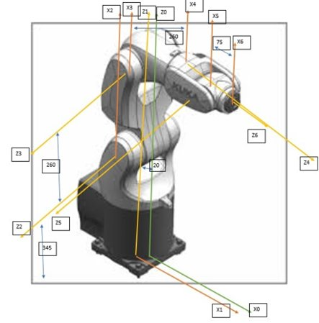
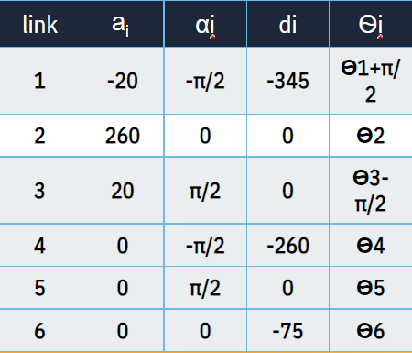
DH PARAMETERS OF KUKA KR3

Slide 15
FORWARD
KINEMATICES

Slide 16
FORWARD KINEMATICS
The forward kinematics problem involves finding the end-tip position of a manipulator in a coordinate space given its joint parameters (i.e., joint angles for revolute joints and link offset for prismatic joints). This means that given a certain pose of a robotic arm, the xyz coordinates of the hand must be determined.
From the DH Table, we calculate the transformation matrix

Slide 17
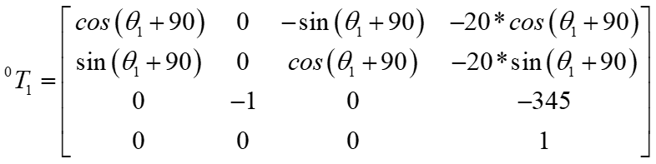
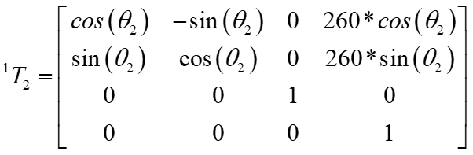
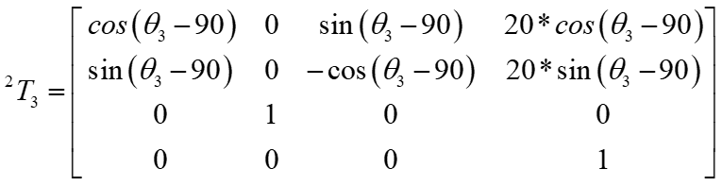

Slide 18
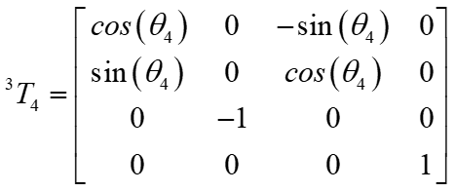
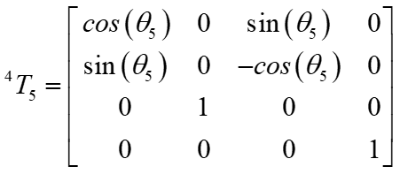
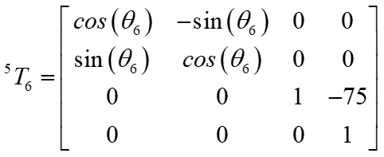

Slide 19
SUCCESIVE TRANSFORMATION

Slide 20
INVERSE
KINEMATICS

Slide 21
INVERSE KINEMATICS
Kinematics is the study of motion without considering the cause of the motion, such as forces and torques. Inverse kinematics is the use of kinematic equations to determine the motion of a robot to reach a desired position. For example, to perform automated bin picking, a robotic arm used in a manufacturing line needs precise motion from an initial position to a desired position between bins and manufacturing machines. The grasping end of a robot arm is designated as the end-effector. The robot configuration is a list of joint positions that are within the position limits of the robot model and do not violate any constraints the robot has.

Slide 22
It is a method in which, from a desired position and orientation for the effector, to find out what rotation is needed in each joint for the manipulator to make the movement. To simplify the inverse kinematics analysis, the problem can be divided into two parts: position and orientation of the ball handle. The position of the centre of the wrist depends only on the angles θ 1, θ 2 and θ 3, which have been determined geometrically. Wrist orientation, at angles θ 4, θ 5 and θ 6, was determined through the algebraic method.
Orientation of the spherical handle:
Through the multiplication of the homogeneous transformation matrices A 4, A 5 and A 6 we obtain the matrix, and from this we use the rotation submatrix to define the angles θ 4, θ 5 and θ 6.

Slide 23
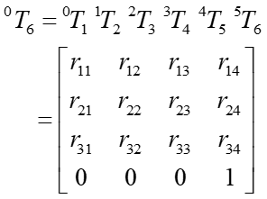
Inverse kinematics is the use of kinematic equations to determine the motion of a robot to reach a desired position.
Determination of joint variables in terms of the end-effector position and orientation
Used to control the configuration of the end effector

Slide 24
Solutions of Inverse kinematics can be split into two categories
1. Closed form solutions: In which the forward kinematics
may be rewritten in a manner that leads to a set of highly
structured non-linear equations that may be solved explicitly
for the joint variables.
2. Numerical solutions: In which a numerical algorithm is applied that explicitly generates all
solutions in a computationally feasible manner. Eg – Newton Raphson's Method

Slide 25
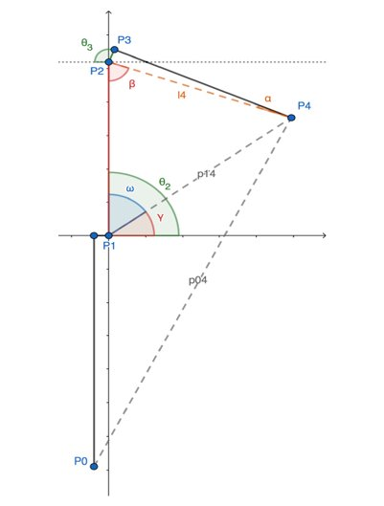
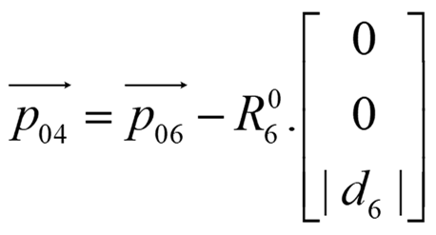
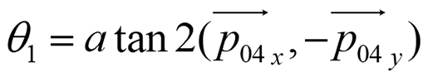
Decoupling method
Possible to decouple the inverse kinematics problem into two sub problems known as inverse position and inverse orientation
Both the problem deals only with three unknown parameters.
Finding Θ1 , Θ2 , Θ3
P04 can be obtained by a translation d6 under the z6 axis from the joint6, p06.
Finding θ1 : For finding the θ1 we need to first find P04 which can be obtained by a translation d6 under the z6 axis from the joint 6, P06.

Slide 26
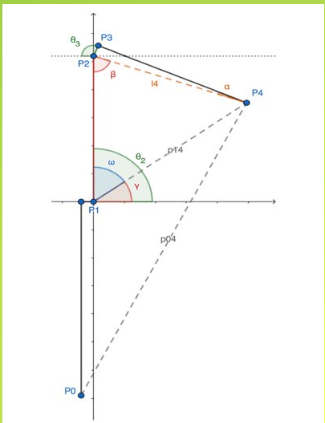
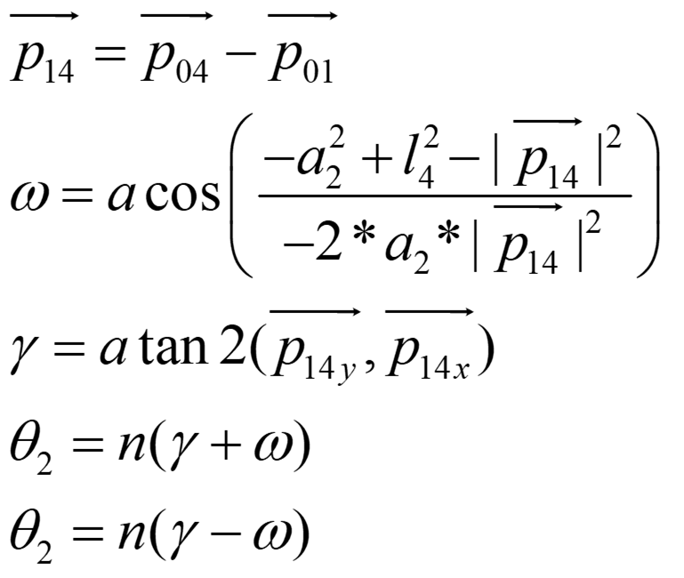
Finding θ2 : Before finding the θ2 as we can see from the geometric analysis figure shown above, we need to P14 , γ and ω. ω can be obtained using the cosine law of SSS triangle.

Slide 27
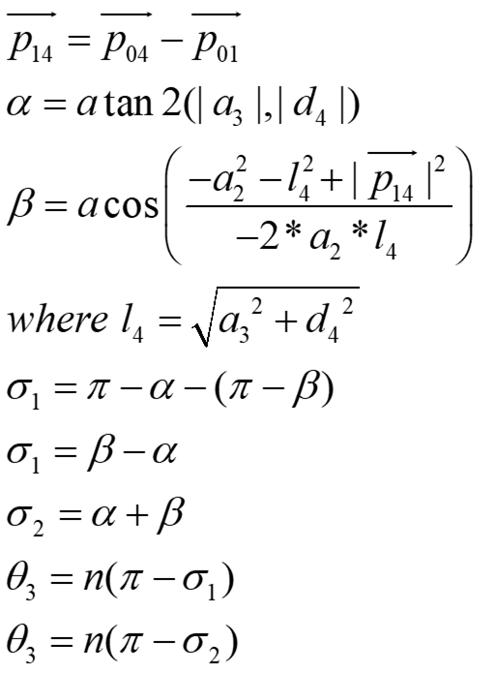
Finding θ3 : You can either start finding θ2 first or θ3 . Since we obtained P14, we need to find the β and α. β can also be obtained by using the cosine law for SSS triangle. Considering that the sum of the internal angles of any triangle equal to π and then the adjacent angles equal to π-β.

Slide 28
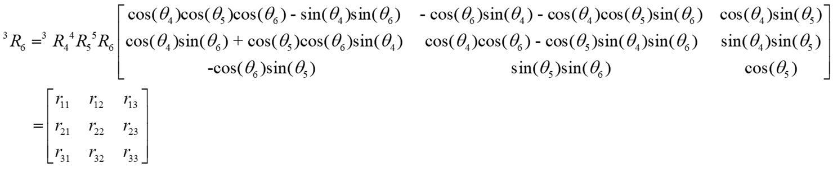
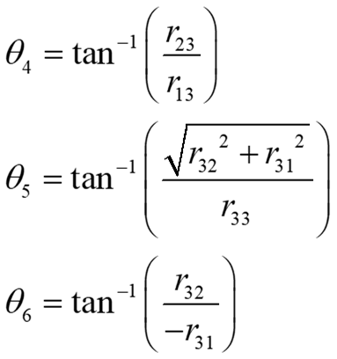
Finding Θ4 , Θ5 , Θ6
Inverse Orientation
Through the rotation matrix (4R6) we can obtain the other three joint variables namely θ4, θ5,and θ6.

Slide 29
NEWTON-RAPHSON METHOD
Newton's approach is applied to the inverse kinematics problem. There are two ways presented. The first technique addresses a six degree of freedom system using a 6 * 6 Jacobian by selecting among the desired T(12), that is 6 elements.
The second approach is to consider all 12 equations relating the 12 components of 0 6Tdes which results in an overdetermined system which must then utilize a pseudo-inverse in implementing Newton’s method.
For the inverse kinematics problem, we employ the first technique.

Slide 30
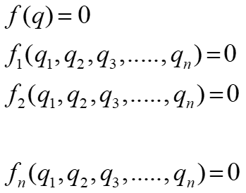
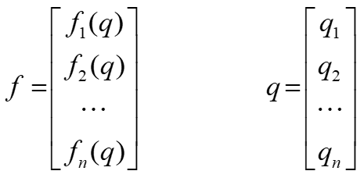
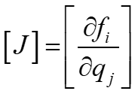
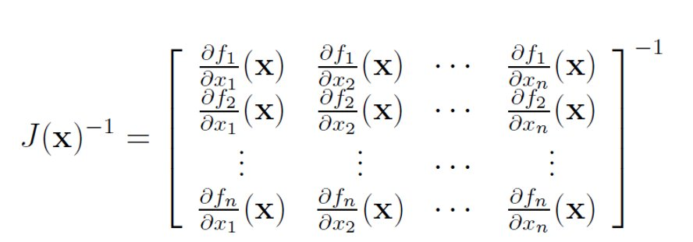
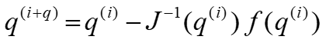

Slide 31
TRAJECTORY PLANNING

Slide 32
Trajectory Planning
The target of the trajectory planning is to generate the reference inputs for the manipulator control system that ensures the implementation of the desired movement. It can be assumed that a trajectory planning algorithm takes as inputs the geometric path, the kinematic and dynamic constraints of the manipulator; the output is the trajectory of the joints, or of the end-effector, expressed as a sequence of values of position, velocity and acceleration

Slide 33
Trajectory planning is a subset of the overall problem that is navigation or motion planning. The typical hierarchy of motion planning is as follows:
Task planning – Designing a set of high-level goals, such as “go pick up the object in front of you”.
Path planning – Generating a feasible path from a start point to a goal point. A path usually consists of a set of connected waypoints.
Trajectory planning – Generating a time schedule for how to follow a path given constraints such as position, velocity, and acceleration.
Trajectory following – Once the entire trajectory is planned, there needs to be a control system that can execute the trajectory in a sufficiently accurate manner.

Slide 34
One of the first design choices you have is whether you want to generate a joint-space or task-space trajectory.
Task space means the waypoints and interpolation are on the Cartesian pose (position and orientation) of a specific location on the manipulator – usually the end effector.
Joint space means the waypoints and interpolation are directly on the joint positions (angles or displacements, depending on the type of joint)
The main difference is that task-space trajectories tend to look more “natural” than joint-space trajectories because the end effector is moving smoothly with respect to the environment even if the joints are not. The big drawback is that following a task-space trajectory involves solving inverse kinematics (IK) more often than a joint-space trajectory, which means a lot more computation especially if your IK solver is based on optimization.

Slide 35
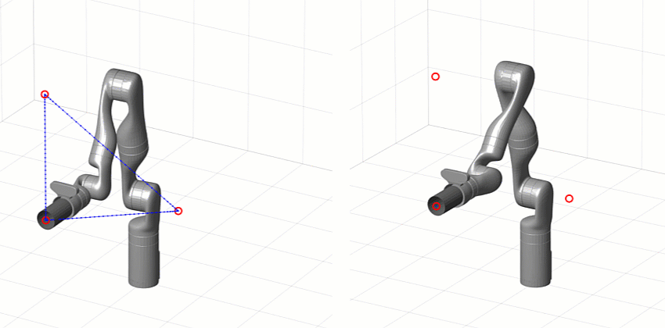
Task space
Joint space

Slide 36
FUTURE SCOPE
•By providing intuitive and intelligent automation solutions, KUKA will support manufacturing companies of any size to meet tomorrow’s requirements.
•Mission 2030 focuses KUKA’s efforts to meet these worldwide shifts with its global network and expertise in robotics combined with flexible, data-driven automation solutions. Bringing industrial intelligence to every corner of the planet and providing easy access to robot-based automation, that is KUKA’s goal – not only improving the experience of automation for those who are already experts, but allowing even inexperienced newcomers to benefit from intuitive implementation and simple operation of automation solutions.

Slide 37
CONCLUSION
The robot Kuka KR3 has as a cinematic arrangement the structure of a human like manipulator.
The Kuka Robot Language (KRL) is the industry standard programming language for Kuka industrial robots. It's a text-based language that allows you to declare data types, specify simple movements, and interface with tools and sensors via I/O operations.
While the KRL provides an easy-to-use interface for industrial applications, it is severely constrained for research. Because the KRL is tuned to the underlying controller, it only provides a fixed, controller specific set of instructions.

Slide 38
THANK YOU

